Slide 1

FEDERATION OF KARNATAKA CHAMBERS OF COMMERCE & INDUSTRY
K.G. ROAD, BANGALORE 560 009

Slide 2
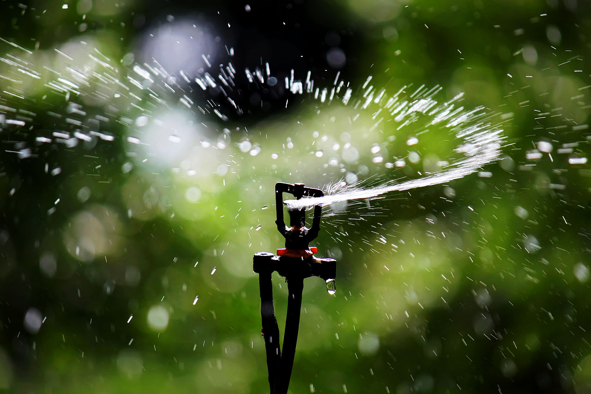

KRISHI MITRA
Smartness in Agriculture
Team members :
U Ashay Thamankar
Ravindra
Rakshith
Rashmitha
Trupthi D L

Slide 3
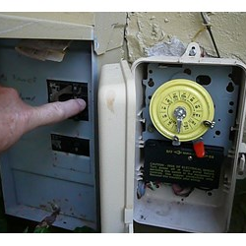
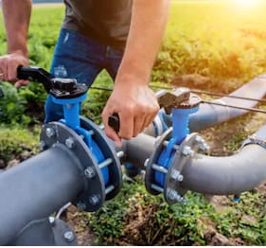
Problem statement
To introduce a smart irrigation system in traditional agricultural applications that results in optimal water usage, there by complimenting the farmers with decreased burden and labour cost.

Slide 4
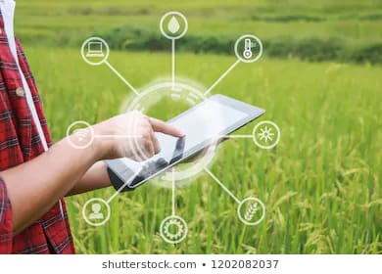
Objective :
To accomplish effective utilization of the water in day-to-day agricultural application.
The application could be in agriculture field, filling of water tank, cleaning cattle shed, proportionate water flow for cow dung pits, sprinklers etc. by a user friendly application interface.
Remotely monitoring the agricultural field through application.

Slide 5
About project :
The prime focus of this project is to introduce an effective and reliable agricultural irrigation system.
Work includes watering to preferred area of agricultural field, automatic filling of water tank, drip irrigation, continuous flow,day-to-day household chore etc.
Design and development of mobile app for managing the applications to assist farmers.

Slide 6


Existing Approach
What is new in the project ?
switching on/off of motor through android application by call/SMS.
Controlled irrigation to preferred areas of field.
Agriculture related news will be given in their regional languages.
Purpose is to solve problems in irrigation with the help of government policies and support plans available for farmers’ benefit.
The switching on/off of motor using call and SMS.

Slide 7
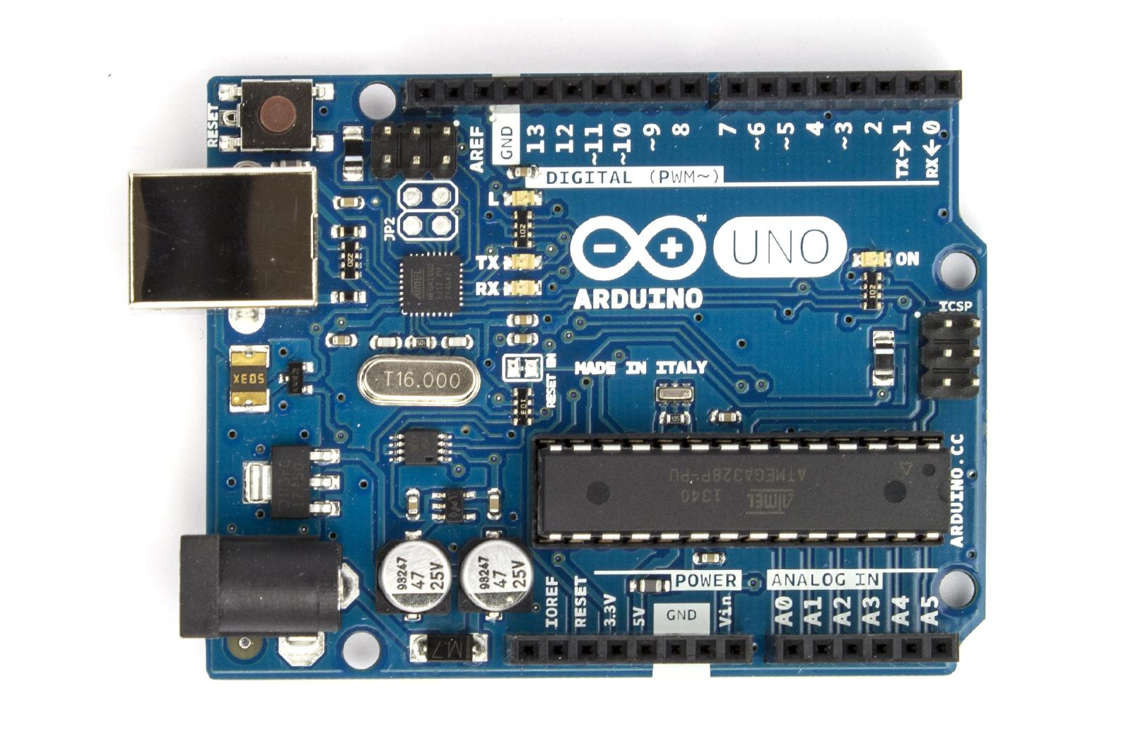
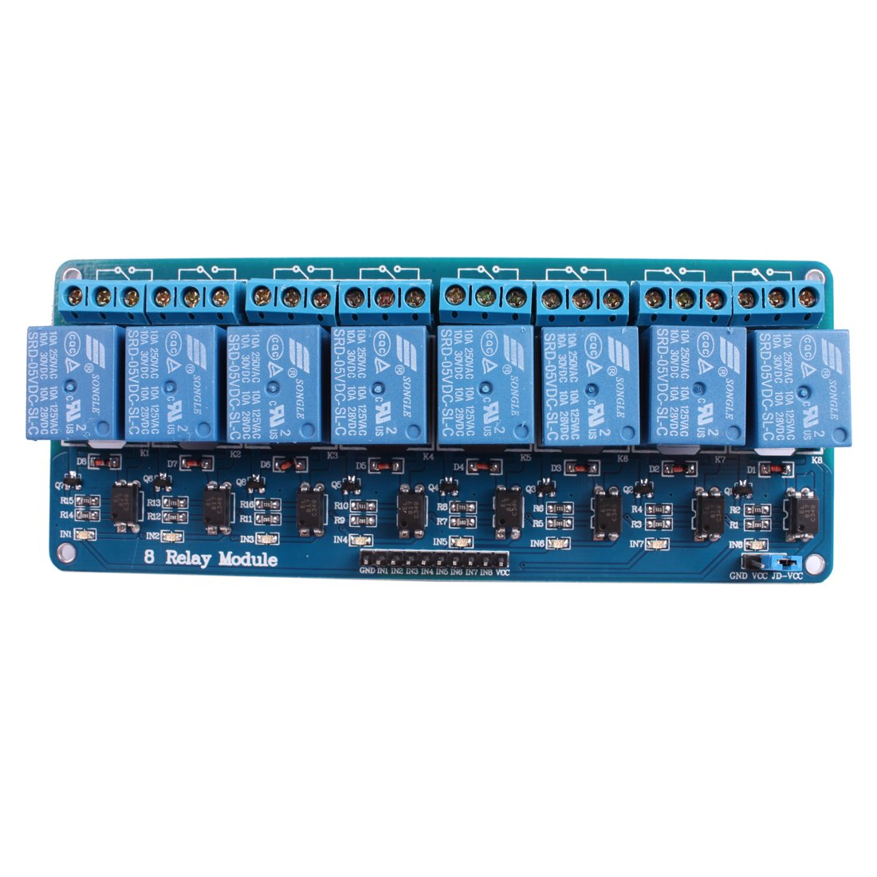
Components Used
Microcontroller
Relay board

Slide 8
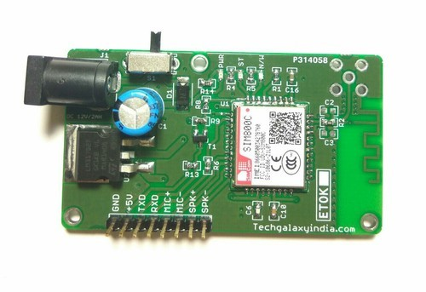
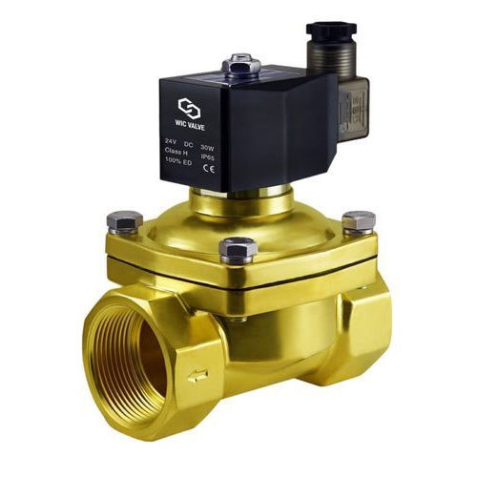
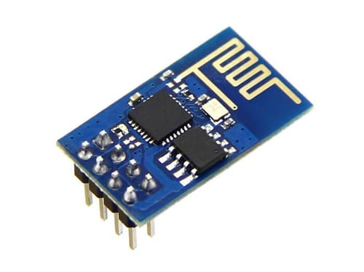
GSM module
Solenoid valve
Wi-fi module

Slide 9
Block Diagram
Water Source
USER
Power supply
Motor
Solenoid valve 1
Agricultural field
Power supply
GSM/Wi-Fi Module
Microcontroller
Relay
Solenoid valve 2
To fill a Tank
Water Source
Solenoid valve 3
preferred area
Signal Flow
Water Flow

Slide 10
Action plan
Gather information like, area of land , different types of crops and soil, variation in land, check water resources, mobile network, regional language, comfort in using new technology and collect queries/feedback.
Check for the availability of resources to accomplish task.
Product demonstration/verification by user.
Testing and verification of pending task and take corrective action to complete fully functional module.

Slide 11
Working team
Mr.U AshayThamankar
Operations
The operations executive is responsible for the operations of the directed plan. And also gives the proper direction to both team member and with respect to external influencer.
Mr.Ravindra
Technical
Recommending and guiding methodologies involving data collection, criteria, and analysis. Preparing and reviewing technical project report. Deals with the technical issues and provides a proper solution.

Slide 12
Cont....
Ms.Rashmitha
Documenting
Responsible for storing data and records for document retrieval and archives moreover, knows excellent oral and written communication skill.
Ms.Trupthi D L
Marketing
Devising and presenting ideas, strategies and marketing the product. Monitoring performance.
Mr.Rakshith
Team Worker
Assist in all the areas and gives suggestions to improve the product.

Slide 13
Industrial Relevance
Product Brief
The smart irrigation system is very helpful for the current scenario.
This project is mainly concentrating on agriculture and this will help the farmer by reducing the labour which will indirectly improve their income.
It is ability to save water. Moreover, it deals with efficient delivery of the water.
It is applicable in rural areas as well. Few of its application could be in agriculture field, filling of water tank, cattle shed cleaning, gardens, small plantations etc.

Slide 14
Market Analysis
Raising importance for efficiency irrigation solutions and watering practices is the key factor drives the growth of global smart irrigation market.
Smart irrigation system are advanced version by this we can control the water flow from remote areas.
Smart irrigation delivers various advantage, including environmental sustainability, reduce labour cost, and also lowers the expense of water usage.
This product is at a very low price which can be afford by the farmer.
Targeted customers are farmers, cultivators, enterprises and individuals.

Slide 15
Financial Aspects
This project is enhancement of basic model. We make it from scratch. Upon many trial and error technique we make efficient and reliable product. The required components are,
Microcontroller (ATmega328) -Rs 140
GSM module (Sim 900A) –Rs 1000
Wi-Fi module(ESP8266) – Rs 430
8 Channel Relay module – Rs 360
LCD display & i2c module - Rs 300
Jumper Wires - Rs 100
PCB Board & Labour Cost - Rs 1000
Protection shield - Rs 230
DTMF decoder(mt8870 ic) - Rs 125
Others (LED, Resisters, Screw, Cables, Capacitor Transistor etc) - 300
In total Rs 3985/- Approximately Rs 4000/-

Slide 16
THANK YOU

